Slide 1
沈少民HOW美术馆作品

Slide 2
锦鲤是中国的国鱼，它代表了中国人的文化认同和精神追求，也是网民们的吉祥物，有着美好的寓意。鲤鱼的生存能力超强，同时具有清理水质的功能。《中国鲤鱼》项目作品将2000条机械鲤鱼放在一张超大的绿色渔网中。这些机械鲤鱼既是人类创造的产物，又是自然界的一部分，它们是否有自己的意识和感情?它们是否能与人类和谐共存?鲤鱼的命运反映了人类对自然的侵犯和疏远，以及自然对人类的反馈与惩罚，这个项目引发观众对鲤鱼的生存环境和人类对自然影响的思考。作品还传达出一种深刻的警示：那些被罐装的鲤鱼，不仅是商品，也是人类自身的隐喻。鲤鱼的商品化体现了工业和消费主义对文化与生命的异化、剥夺，以及人类对物质、利益的追逐和沉溺，同时也展示了科技与生命的关系，唤起人们对生态和科技的关注与反思。
Koi Carp is regarded as China’s national fish, for it represents Chinese’s cultural identity and spiritual pursuit, and is also a lucky charm and mascot for Chinese netizens. Carps are extremely resilient and can purify water quality. Chinese Carp places 2,000 mechanical carps entangled within a enormous green fishnet. These mechanical carps confront the duality of artificial creation and natural creature. Do they have their own consciousness and emotions? Can they coexist peacefully with their human counterparts? The fate of the carps mirror man’s intrusion and alienation to nature, comes at the expense of nature’s response and punishment. This project serves as a stark reminder on the carp’s living environment and man’s impact on nature. The canned carps, far from being mere commodities, become metaphor of our plight and destiny. The commercialization of carps reveals the alienation and deprivation that rampant industrialization and consumerism brought to culture and life, meanwhile, unveils man’s insatiable desires, relentless chase after profits and indulgence on materials. It unfolds the delicate connection between technology and life, evoking our concerns and reflections on ecosystem and technology.
中国鲤鱼/Chinese Carp
205㎡ 2000条 2018
装置 Installation
硅胶、驱动电机、电子呼吸系统、金属包装盒 Silicone, drive motor, electronic respiratory system, metallic packaging box

Slide 3
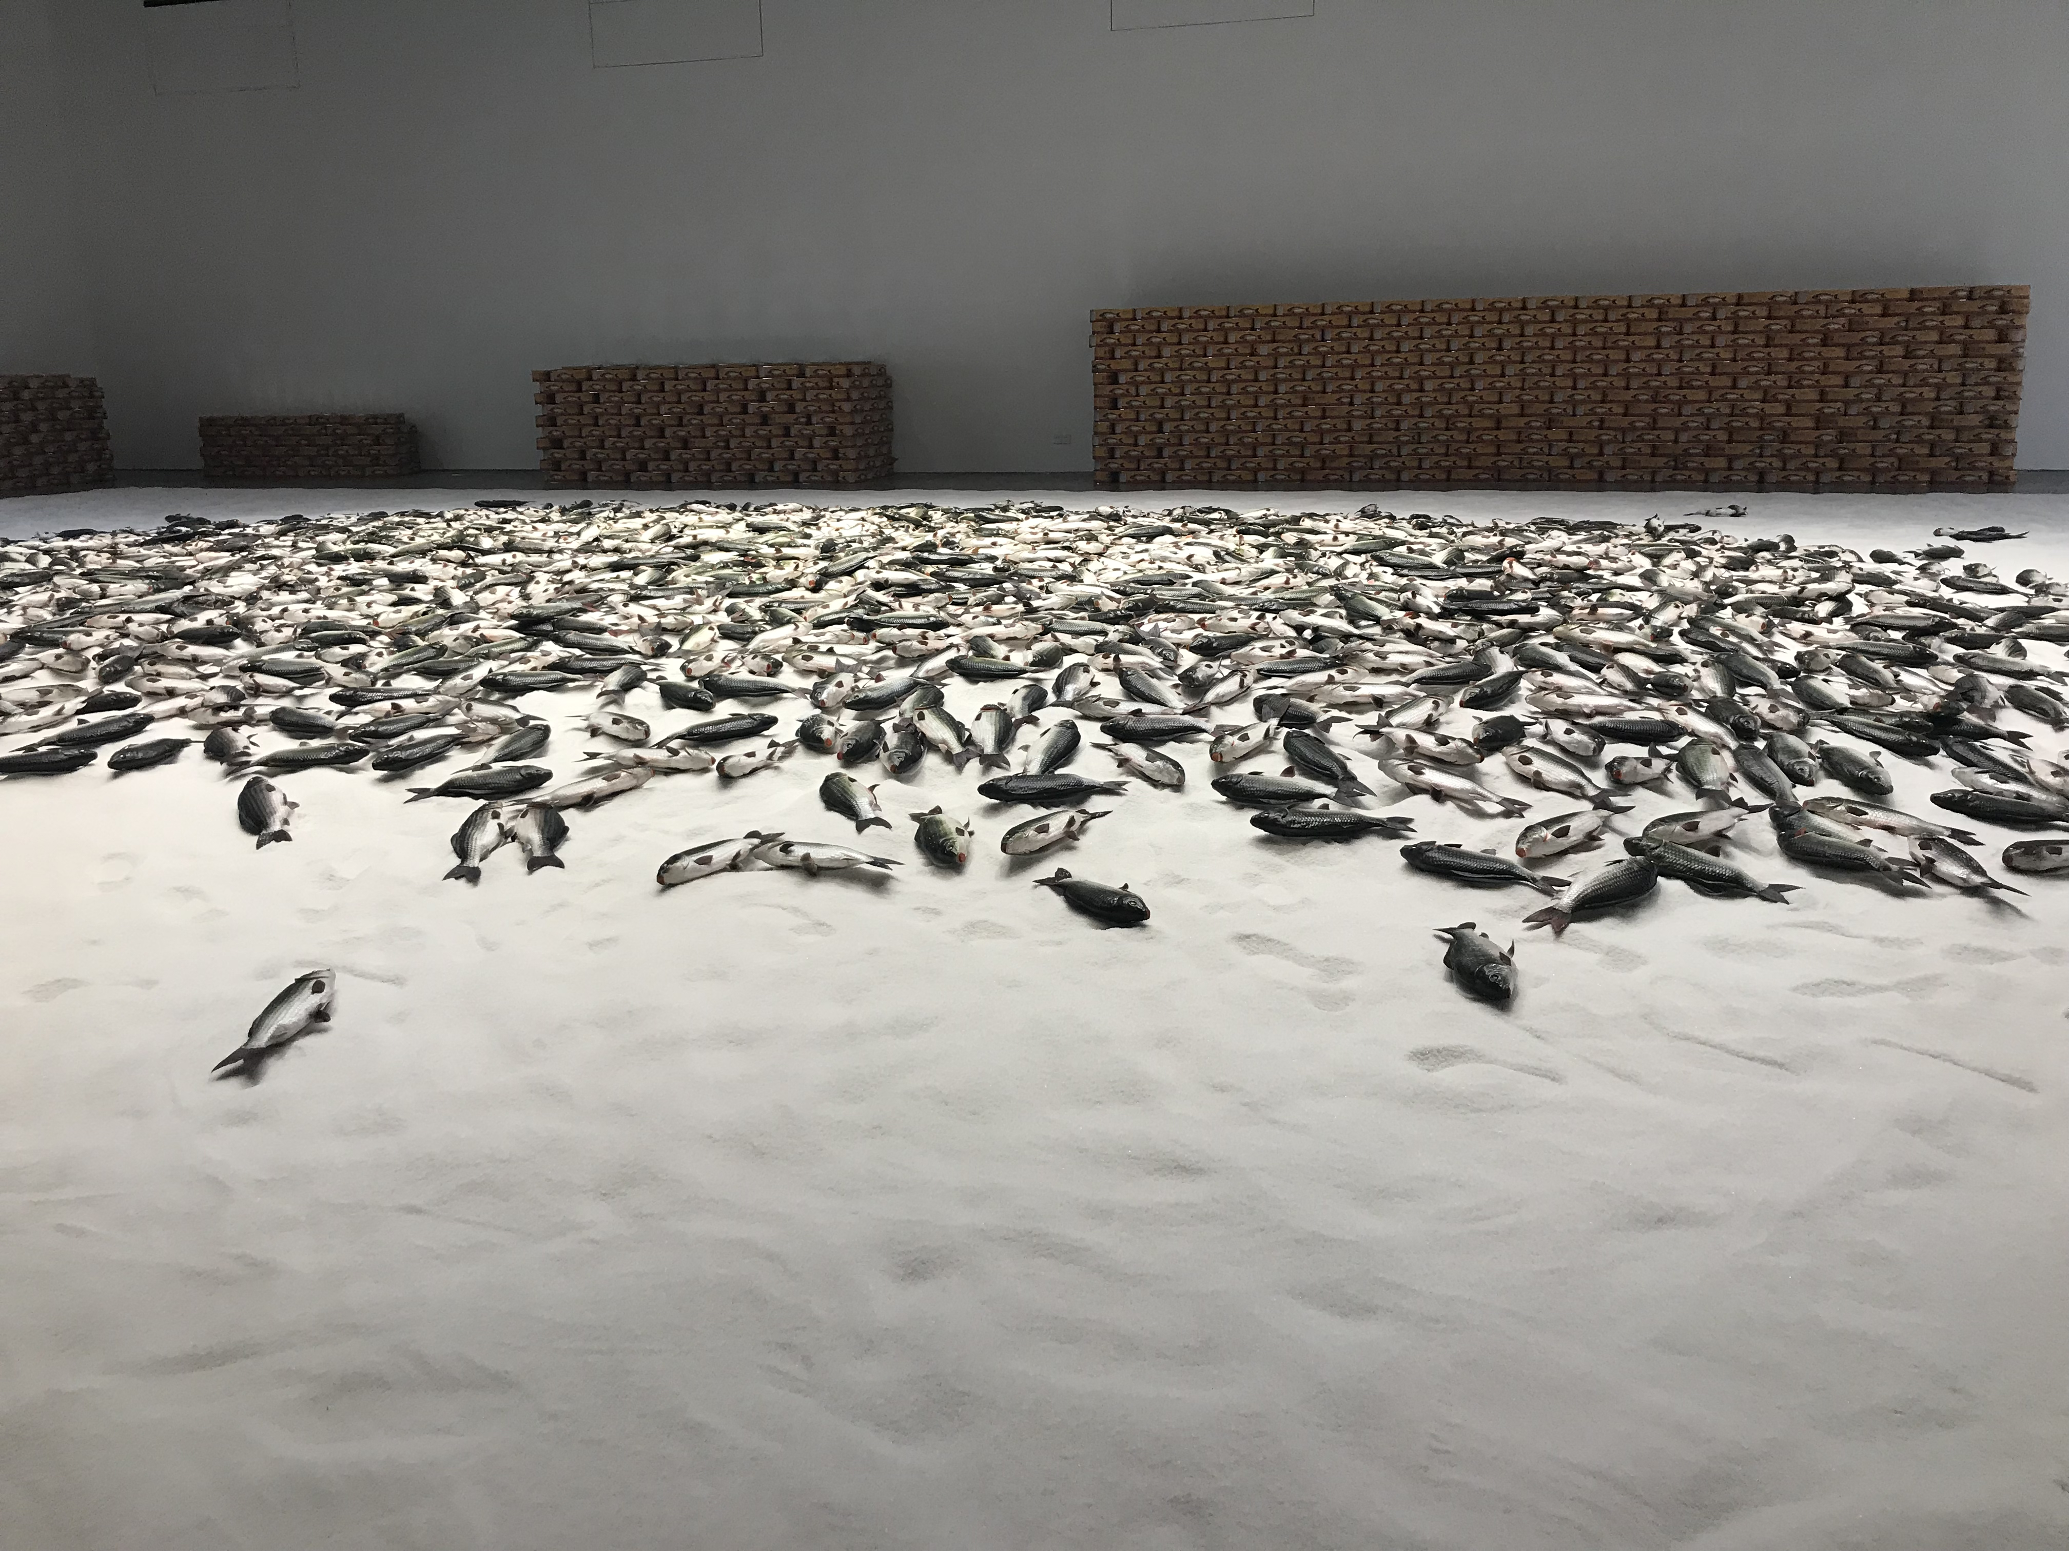
《中国鲤鱼》

Slide 4
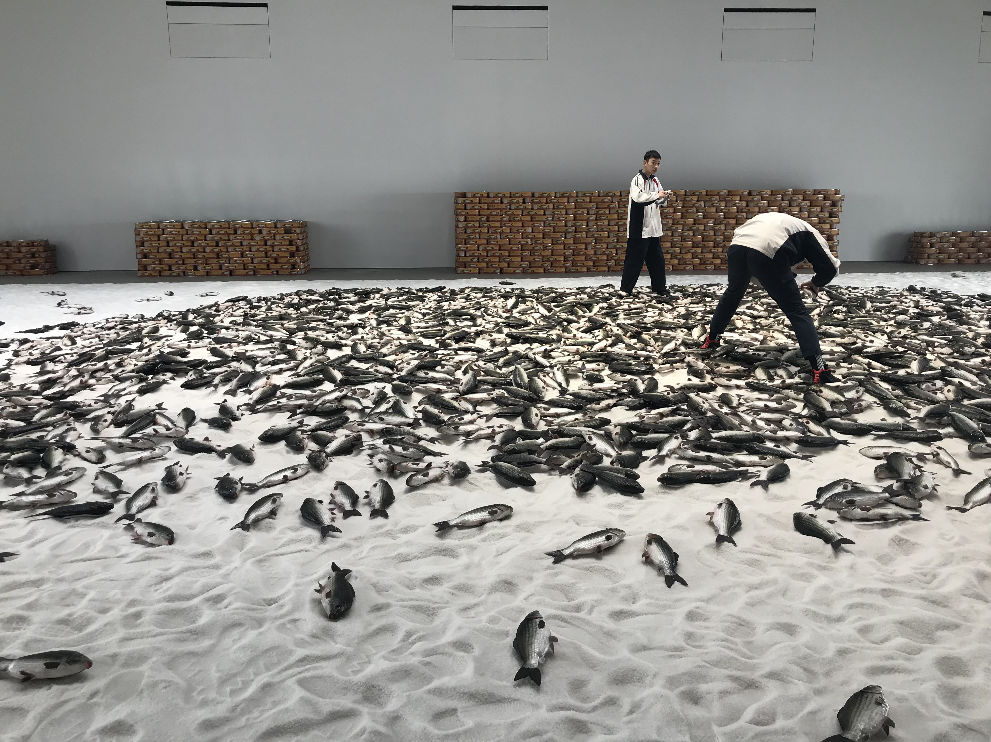

Slide 5
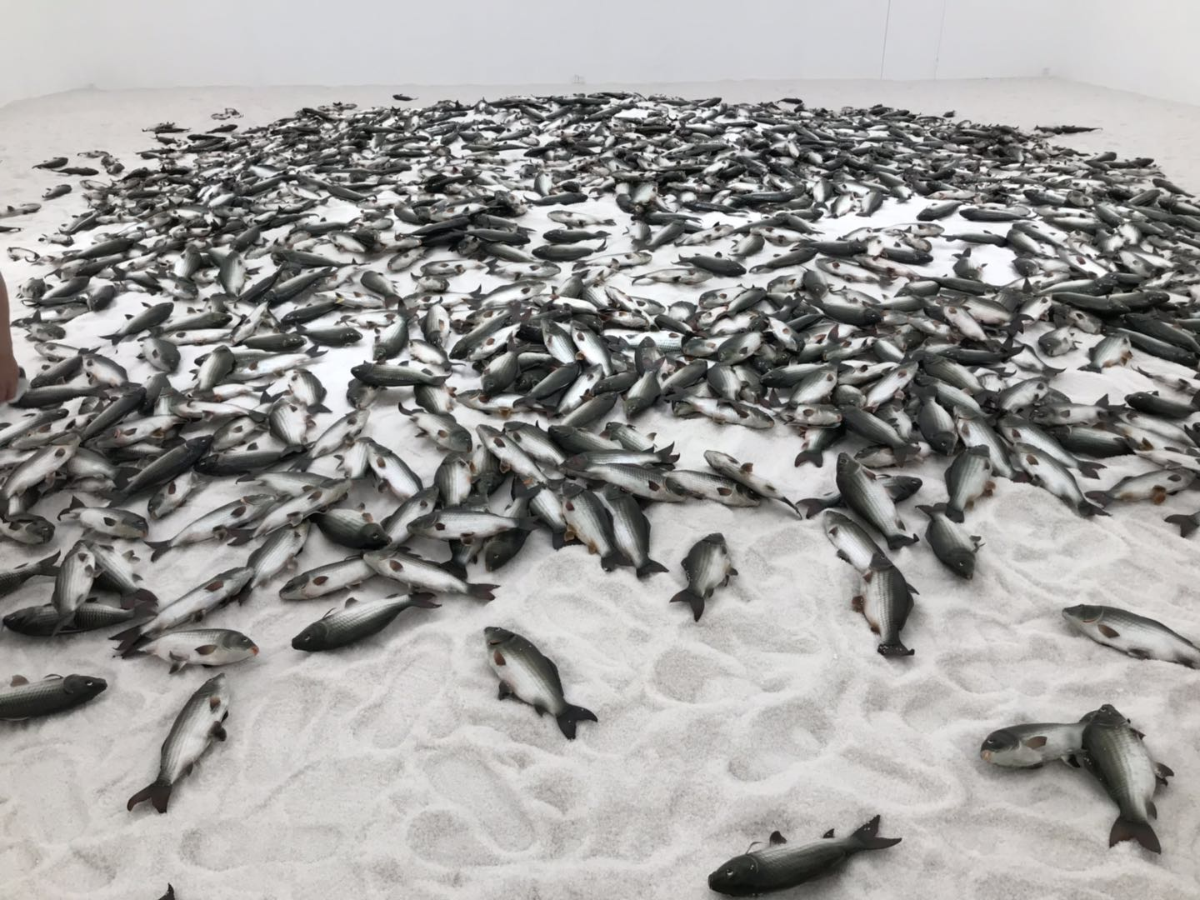

Slide 6
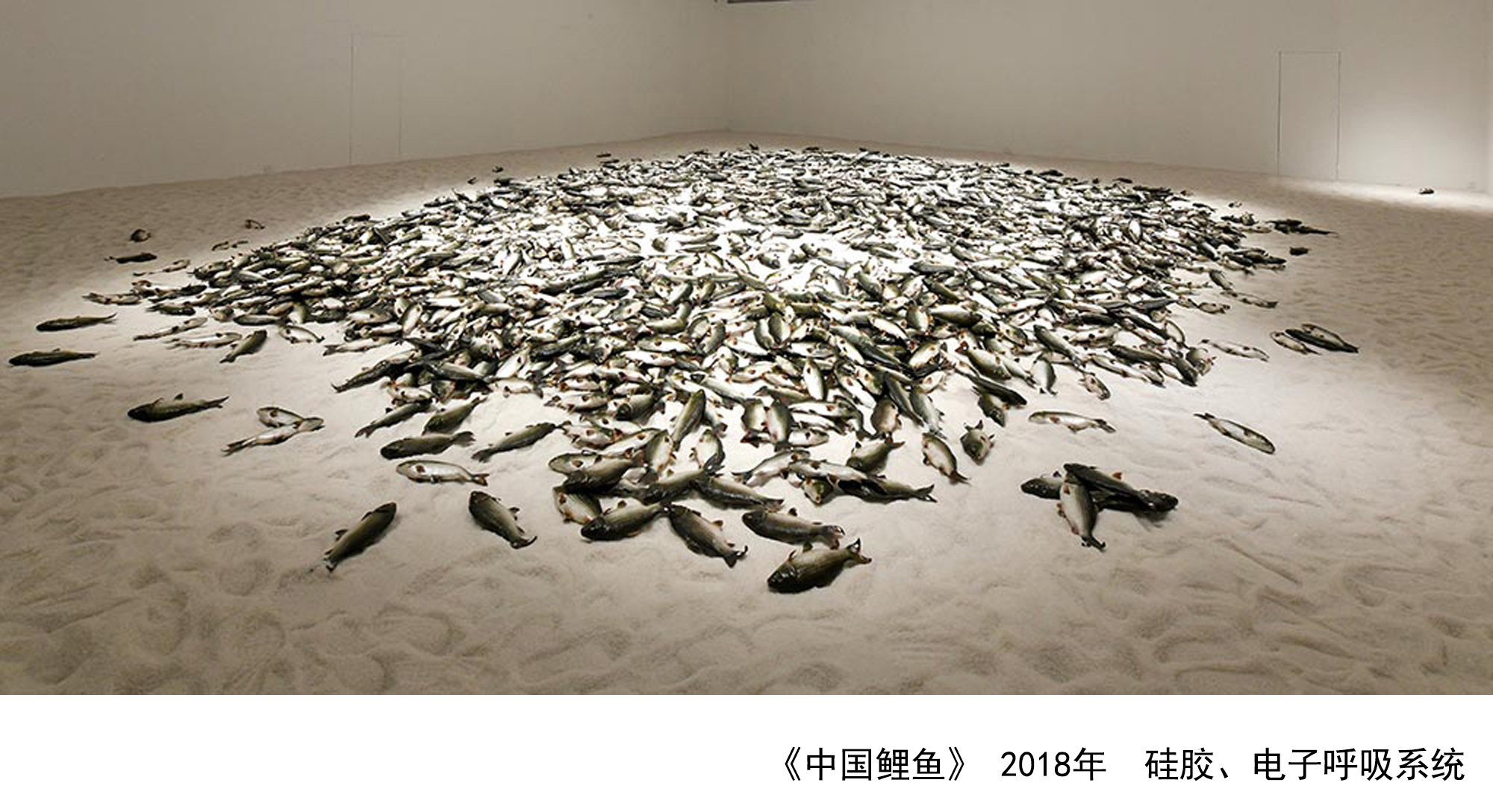

Slide 7
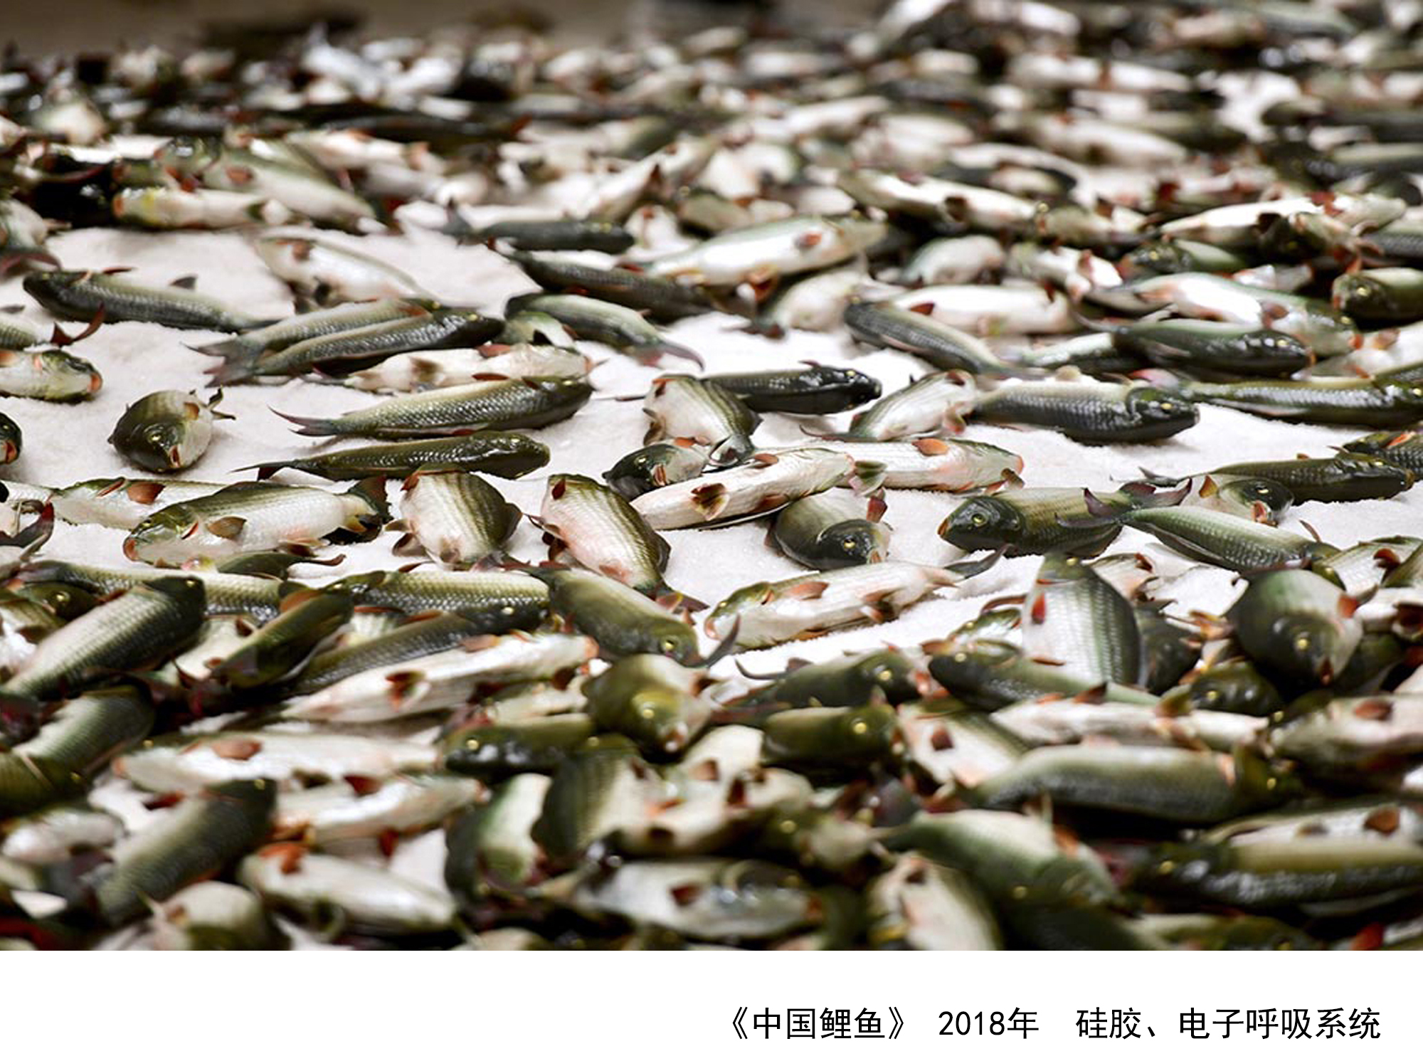
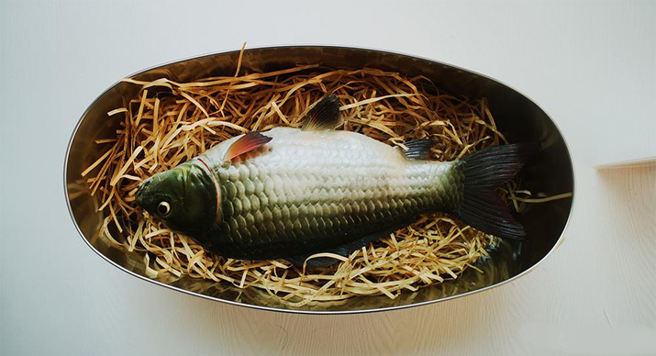

Slide 8
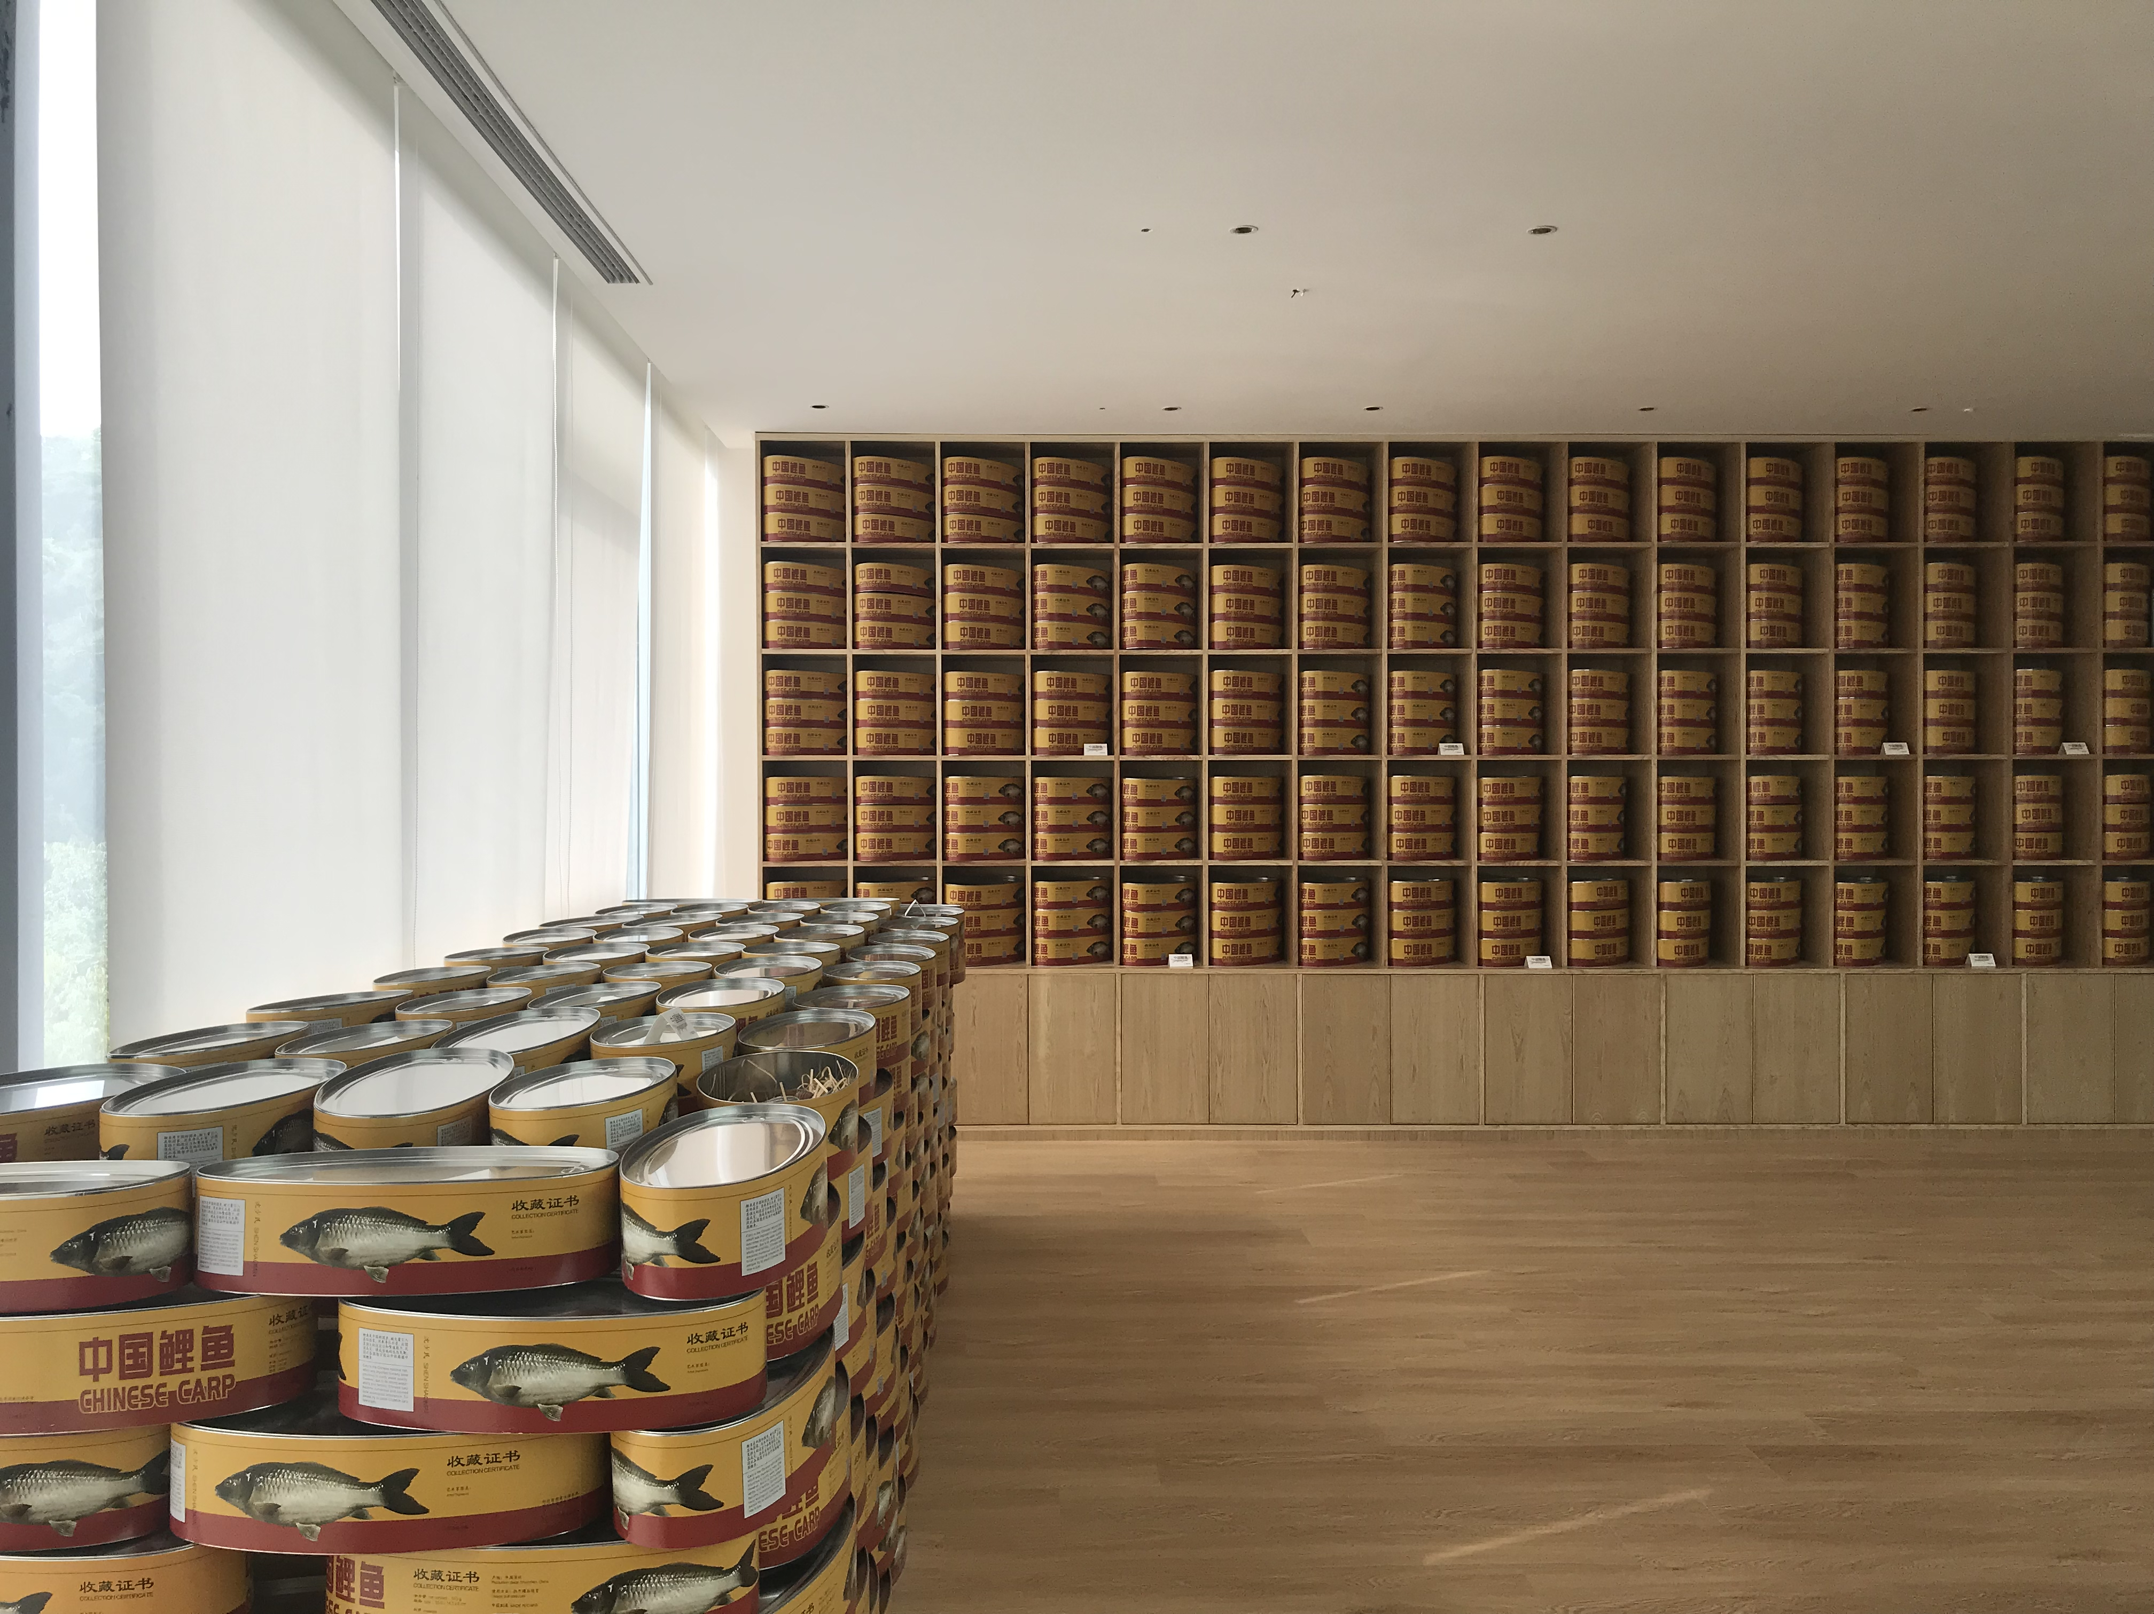

Slide 9
（视频）

Slide 10
燃烧煤——产生电——空调工作——蒸发器把液体变为气体——吸收热量——排除冷风至空间一，同时冷凝器把气体变为液体——释放热量——排除热风至空间二
蒸发器排出的冷风 + 冷凝器排出的热风 = 0
用4组大功率空调机的蒸发器及冷凝器分别置放于两个相同面积的空间，放置蒸发器的空间中产生的冷气将此空间的温度降到极度寒冷的程度。同时放置冷凝器所排放的热量将另一空间变的十分燥热。观众进入不同空间，感受到的则是两种极端差异的气温。人为消耗大量的能源制造出的是两个极端气候的空间，是违背自然规律的行为，是被控制的自然。
Burn coals - generate power - turn on the air conditioner- evaporator converts liquid to vapor - absorb heat - discharge cold air to Space One - condenser converts vapor to liquid - releases heat - discharge hot air to Space Two
Cold air from evaporators + hot air from condensers = 0
Four sets of evaporator and condenser from large-power air conditioner are placed in two identical spaces, with one being extremely cold as evaporators cool down the air, while the other scorching due to the heat released by condensers. When the audience enter different spaces, they'll experience two extremes in temperature artificially created via large energy consumption. The deliberate violation of the natural law embodies the nature controlled by humans.
被控制的自然
Nature under Control
800×300×230cm 2022
空间装置
Space Installation
空调蒸发器，空调冷凝器，金属框架，建筑板材，玻璃，门，灯
Air conditioner evaporator, air conditioner condenser, metal frame, architectural panel, glass, door, lamp

Slide 11
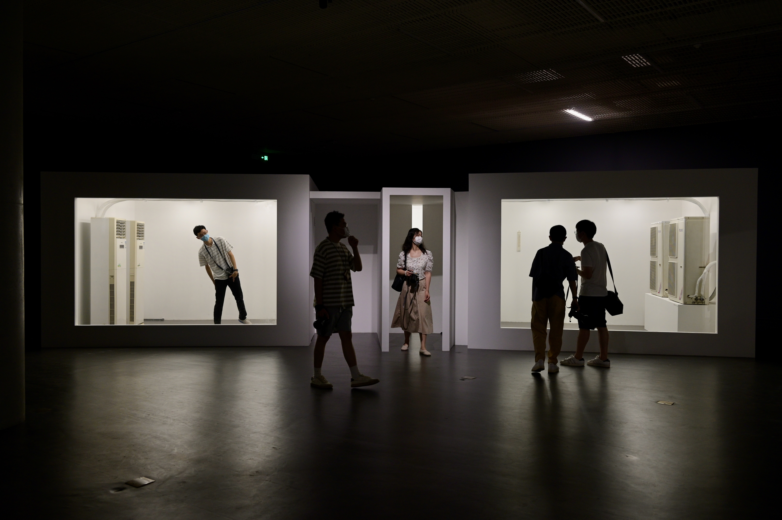

Slide 12
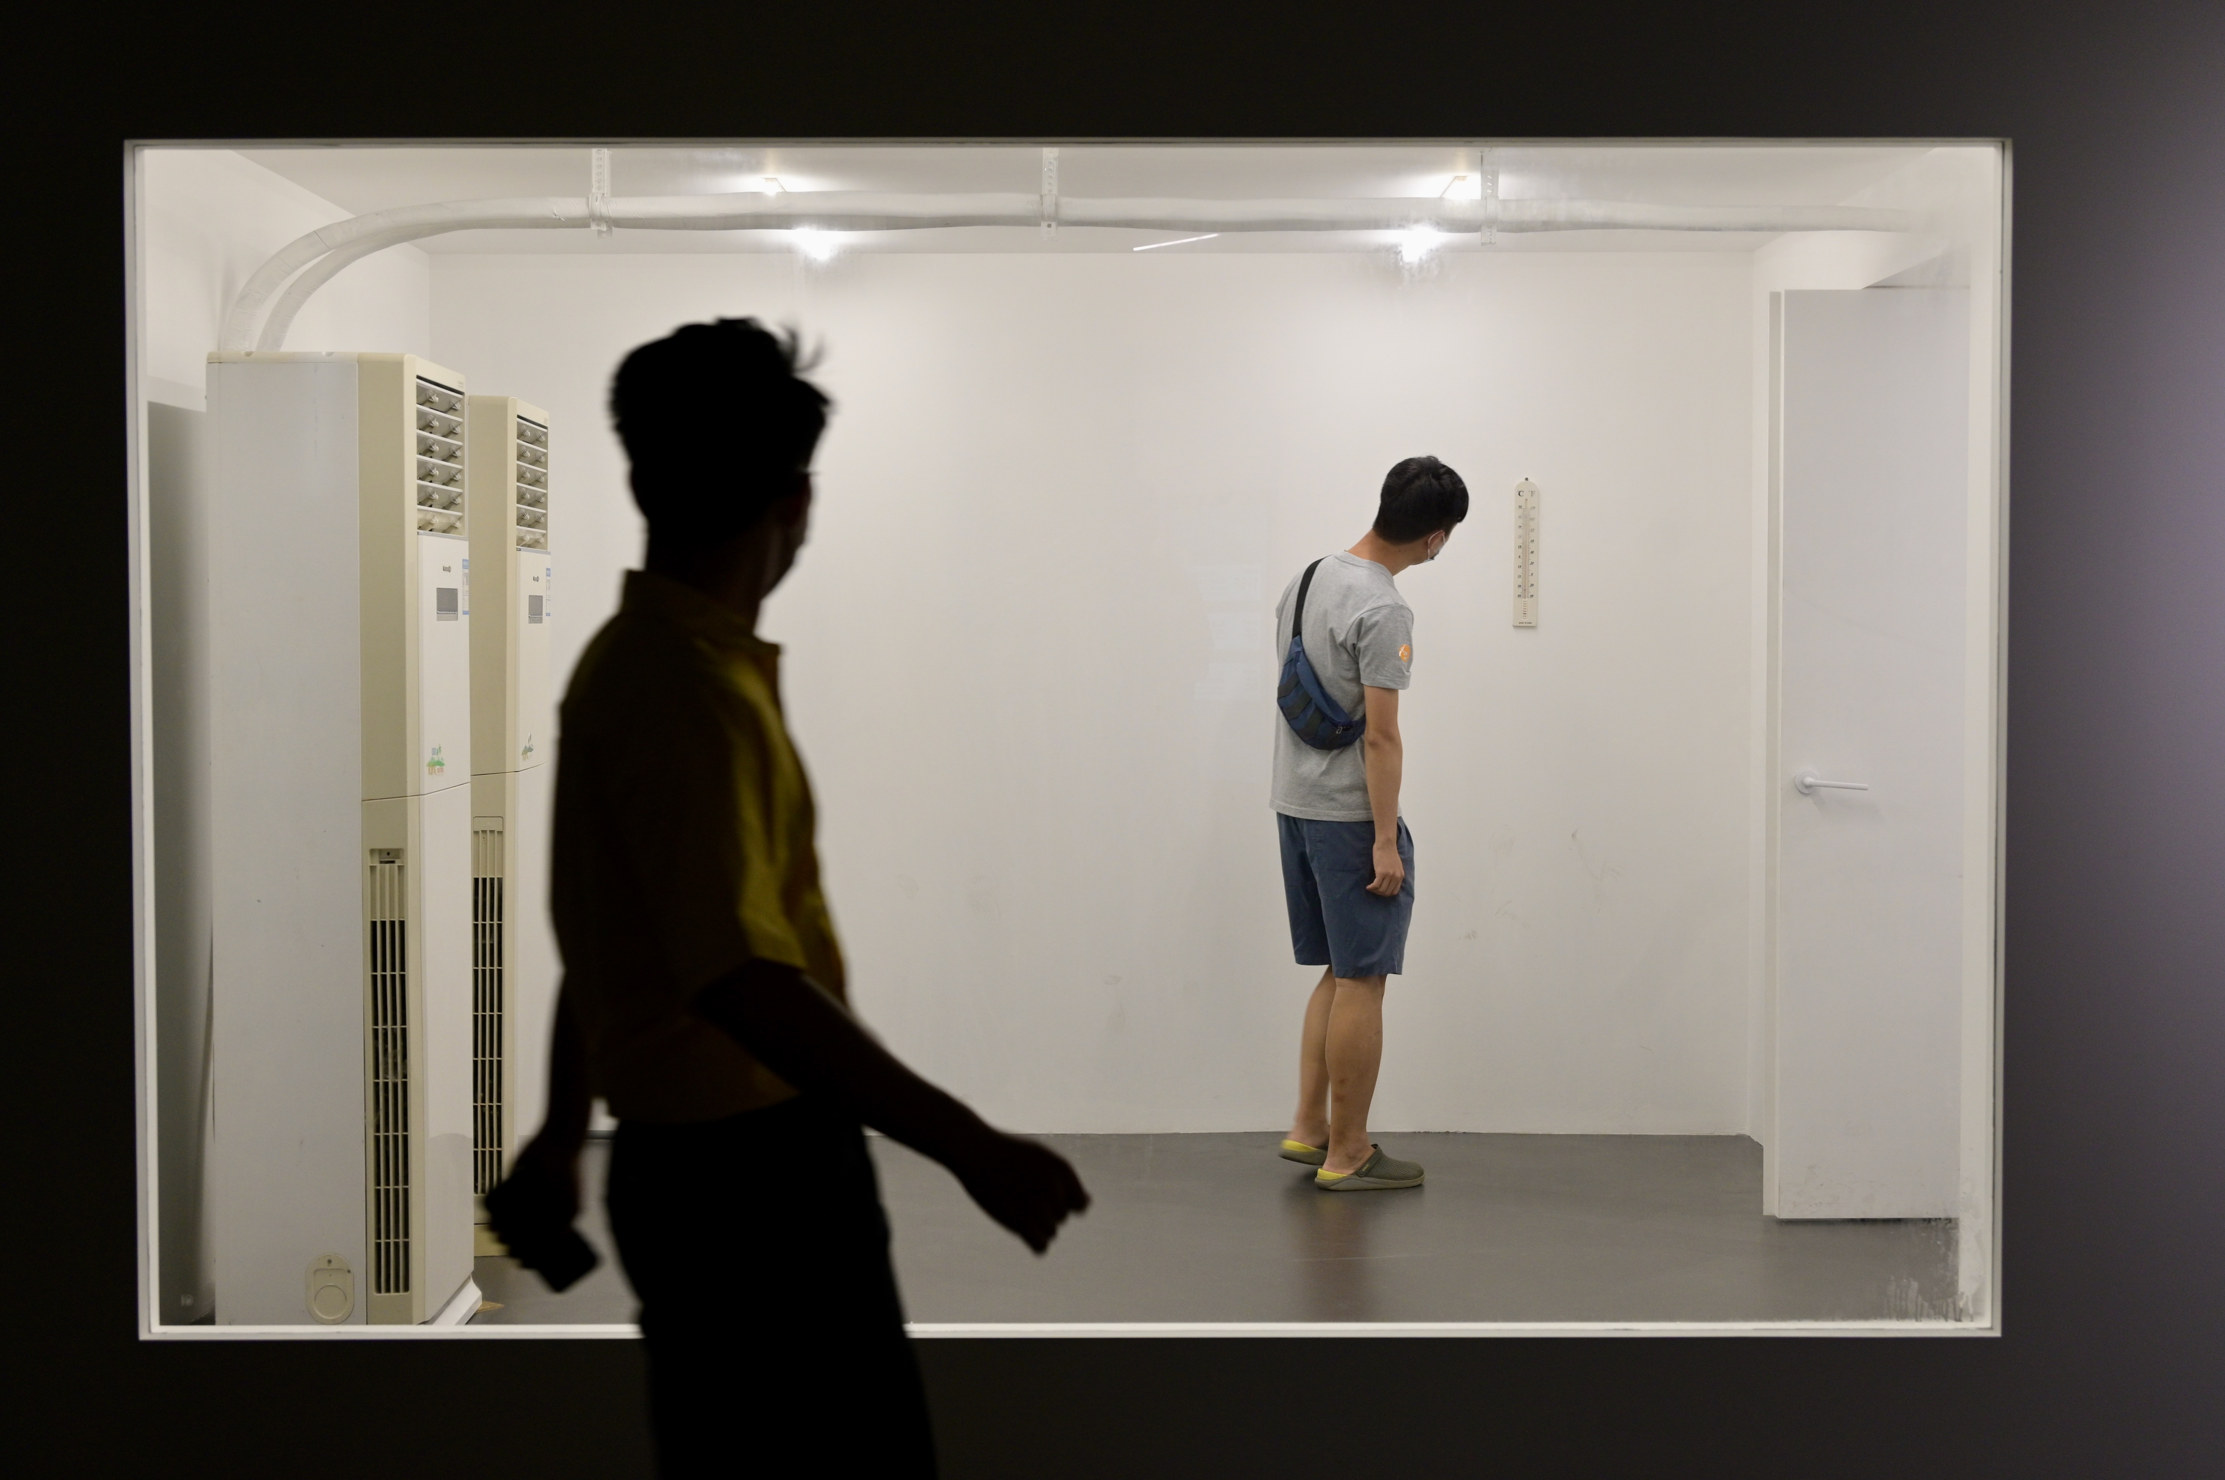

Slide 13
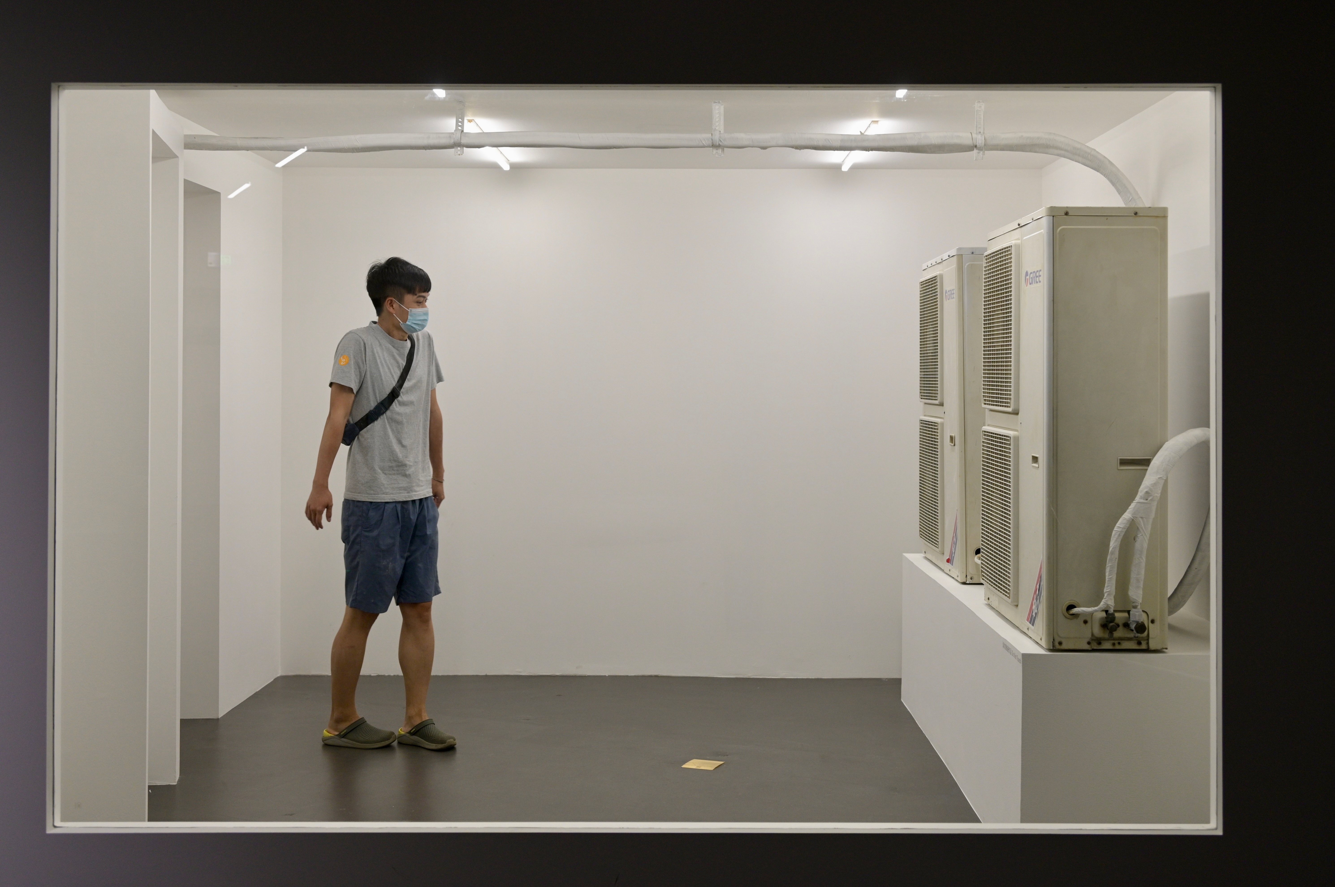

Slide 14
《 被自然困扰的鸟》探索了自然与生命之间微妙的依存关系。这些树原本是鸟类赖以生存的栖息地，如今却反转成为它们的束缚，仿佛变成了一个囚笼。这一反常情境揭示了自然环境在某些条件下如何从庇护所转变为桎梏，反映了生态系统的脆弱性。当自然环境发生变化时，原本和谐共生的关系也随之改变，甚至可能对生命产生压迫与限制。通过这一视觉隐喻，反思人类活动对自然界的影响，以及这些改变如何反过来影响我们自身及其他生命形式的生存空间。
Birds Troubled by Nature explores the delicate interdependence between nature and life. The trees, which once served as essential habitats for birds, have now paradoxically become their constraints, almost transforming into cages. This unsettling scenario reveals how the natural environment, under certain conditions, can shift from being a refuge to becoming a burden, highlighting the fragility of ecosystems. As the natural environment changes, the once harmonious and symbiotic relationships also alter, potentially leading to oppression and limitation of life. Through this visual metaphor, the work encourages reflection on the impact of human activities on nature and how these changes, in turn, affect our own survival and that of other life forms.
被自然困扰的鸟
Birds Troubled by Nature
高度300cm*3 （真树实际大小） 2024
装置
Installation
金属 活体鸟
Metal, living bird

Slide 15
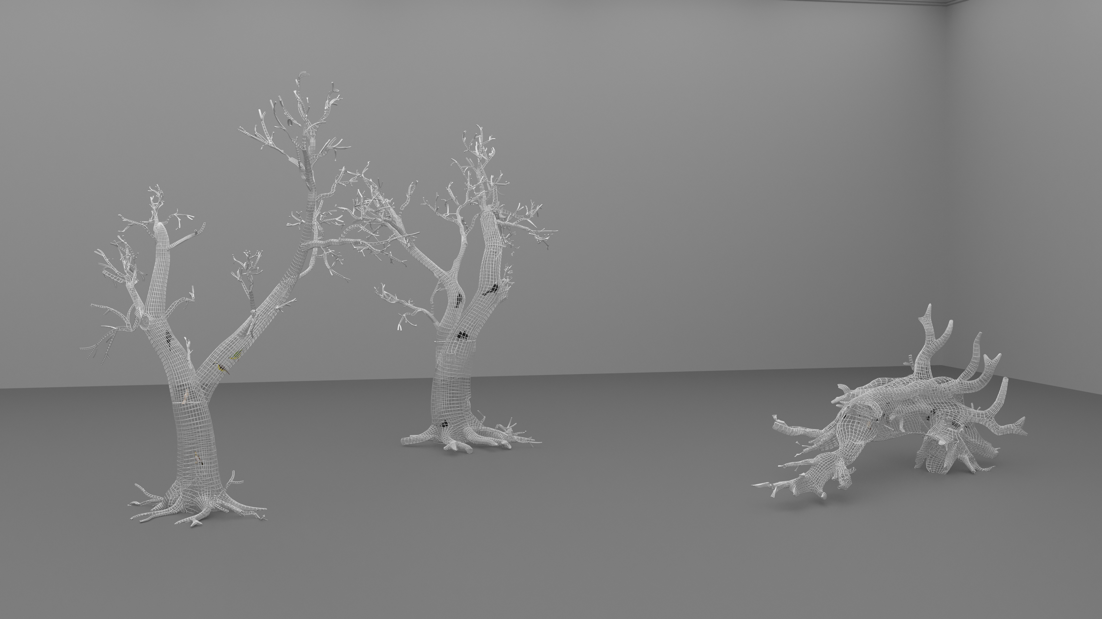

Slide 16
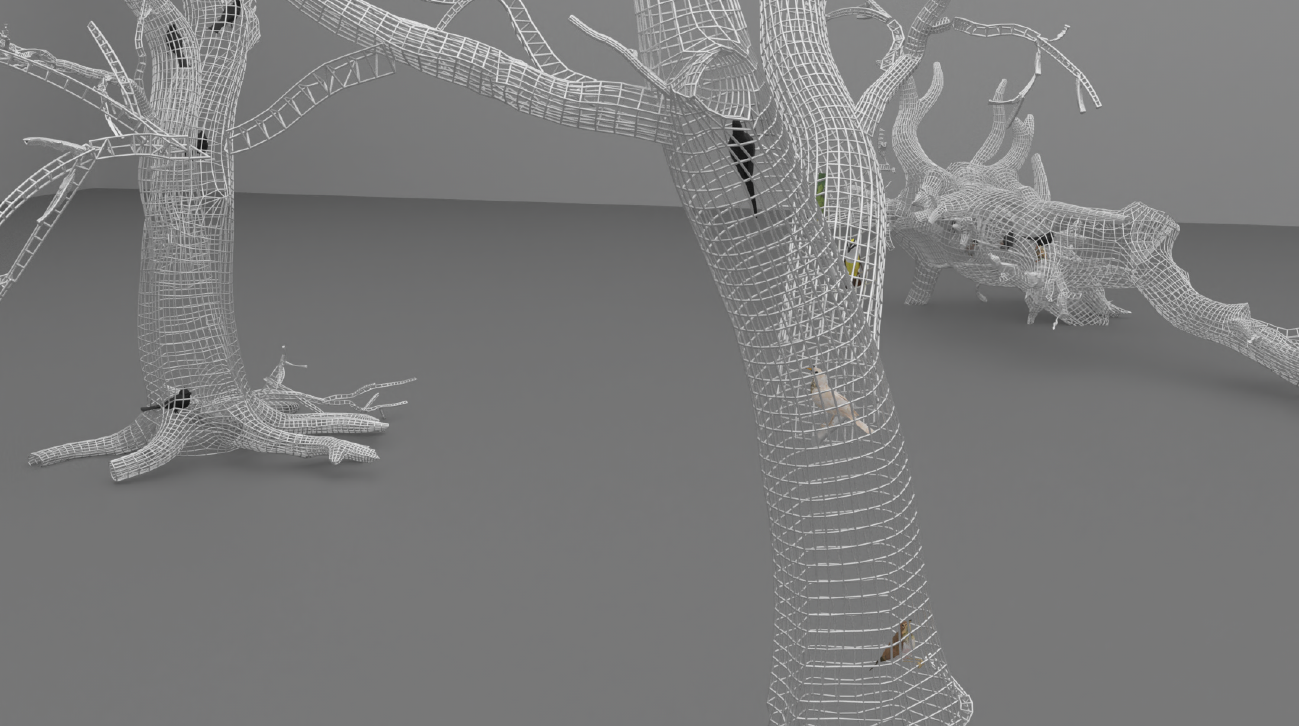

Slide 17
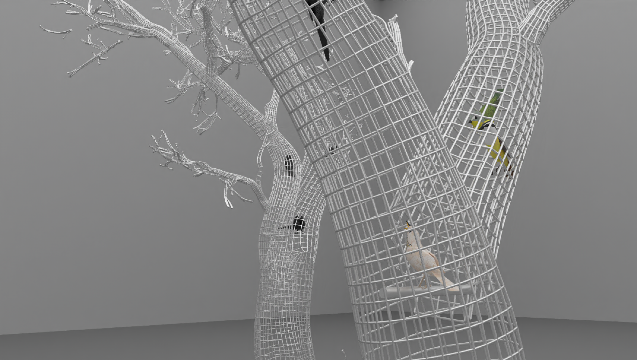

Slide 18
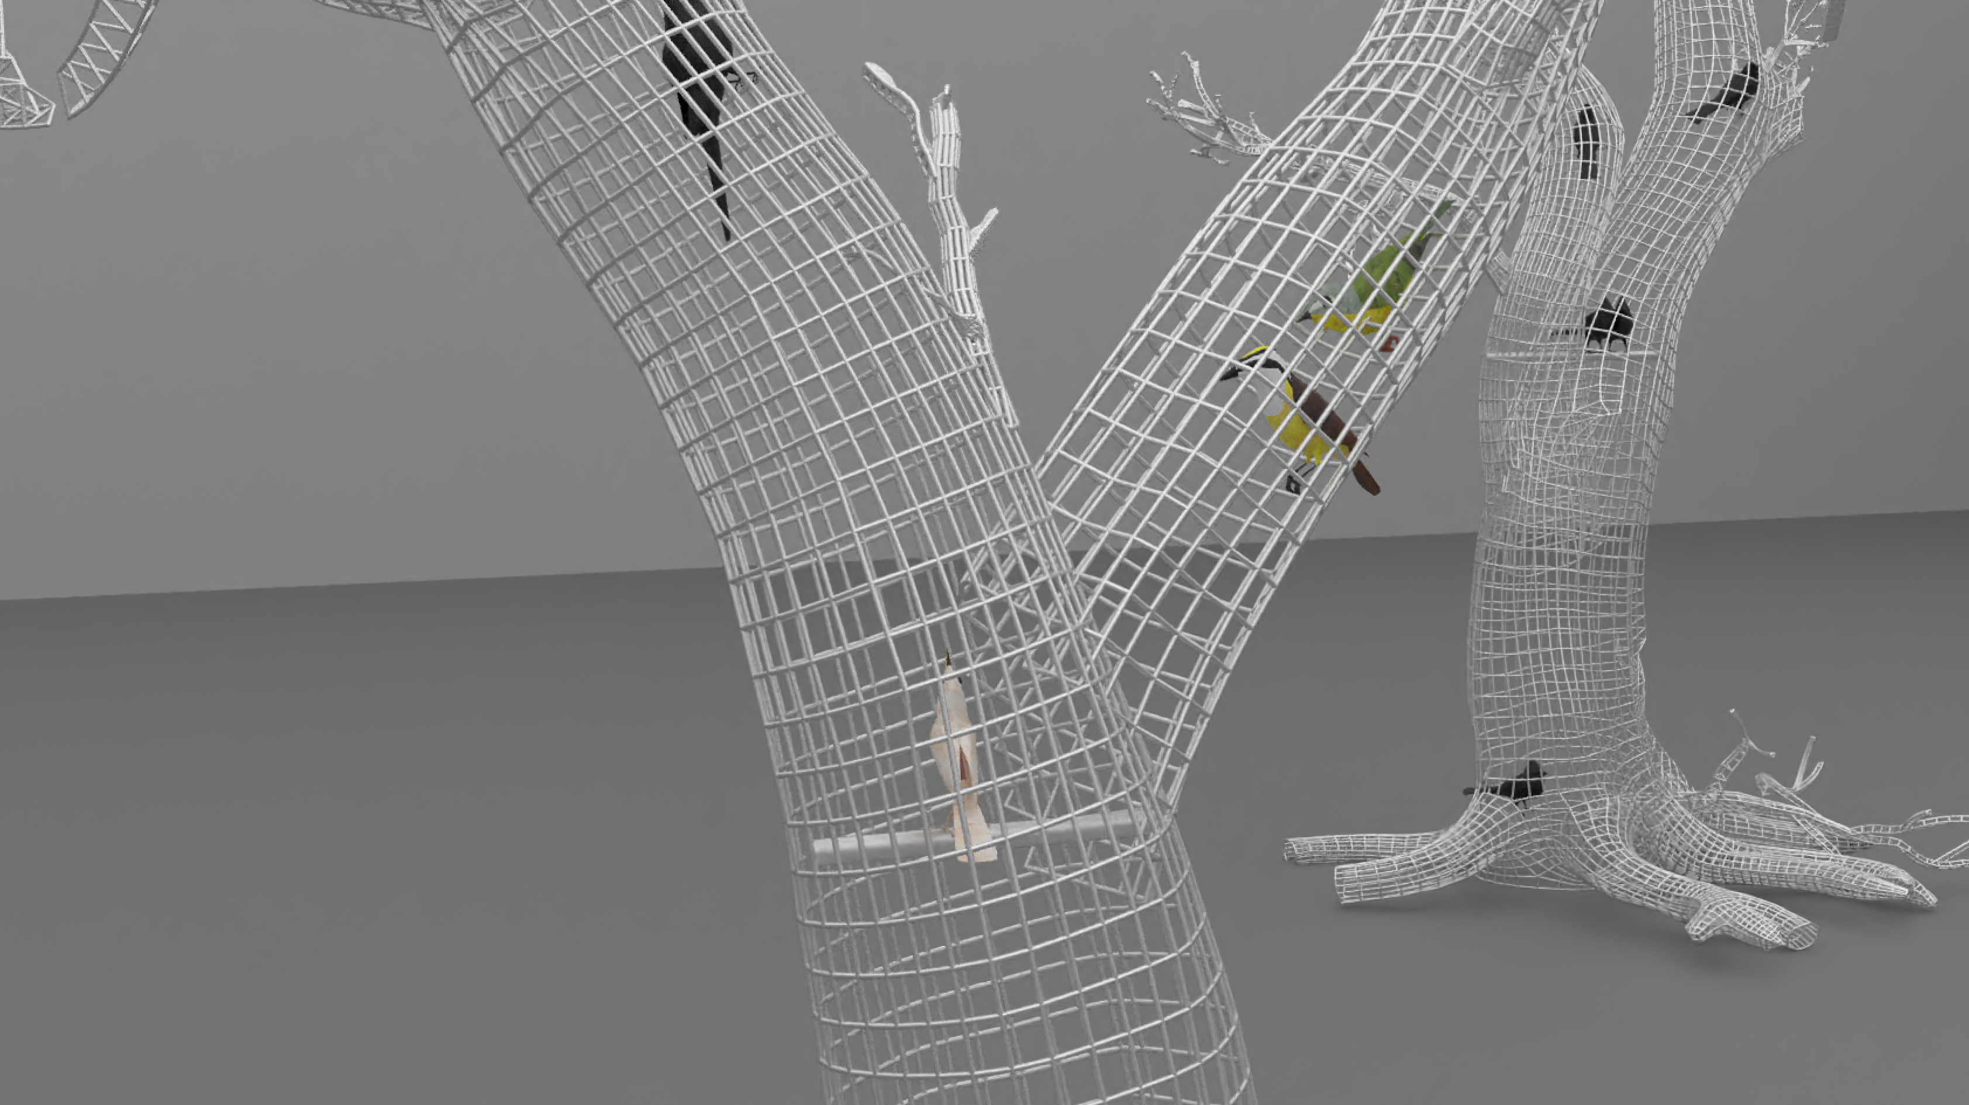

Slide 19
